Slide 1
Summer Vacation under the COVID-19
——Suggestions for International Students

Slide 2
CONTENTS
1
Suggestions on self-protection during the COVID-19 period
2
Suggestions for on-campus students
3
Suggestions for off-campus students

Slide 3
1

Slide 4
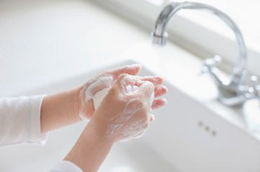
Suggestions on Self-protection
1.Wash your hands under the following circumstances:
Before enjoying your meals
After using the lavatory
Returning home/dorm from the outside
After coughing or sneezing
Before touching your eyes, nose and mouth
After touching animals

Slide 5
Suggestions on Self-protection
2. Reduce the frequency of going out
If you don’t have anything urgent to be coped with, you’d better stay at home or dorm and avoid close contact with people who have the symptoms of flu.

Slide 6
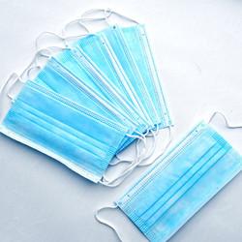
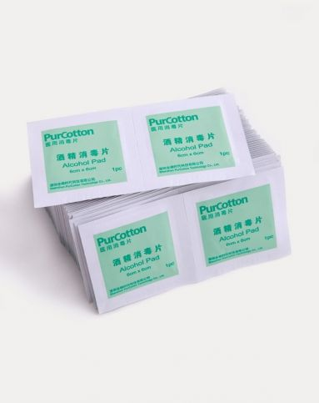
Suggestions on Self-protection
3. Wear a mask
If you must go out, wear a mask and carry disinfection products such as alcohol hand gel and alcohol cotton tablets with you.

Slide 7
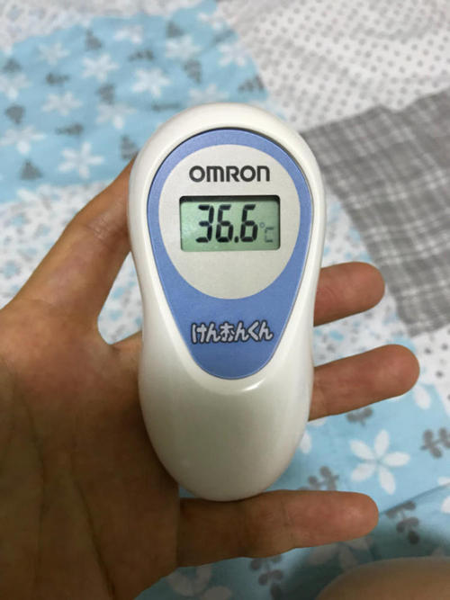
Suggestions on Self-protection
4. Seek for medical service when any of the following circumstances occurs:
Coughing
Fever (body temperature higher than 37.3 ℃)
Difficulty in breathing or feeling pain when you takes a deep breath
Accelerated heartbeat
Worsened situations when the cold or flu is about to recover

Slide 8
2

Slide 9
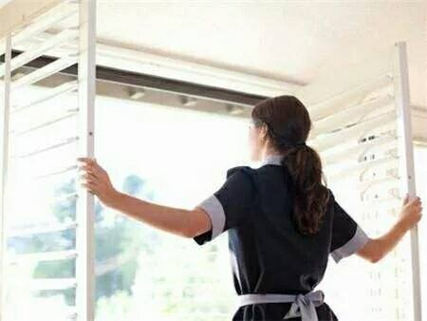
Suggestions for On-campus Students
1. Continue to submit health information and daily health questionnaires or WeChat health report
2. Submit the application form to the class mentor one day in advance to get the access of entry and exit if it is necessary
3. Vantilate your dorms frequently and had better not keep the air conditioner on all day long
4. Do more exercises to improve your immunity system

Slide 10
3

Slide 11
Suggestions for Off-campus Students
Stay in Nanjing
Obey and actively cooperate with local epidemic prevention and control measures during the summer vacation.
Complete the daily health report and timely report your physical condition to the class mentor
4. Do not go to any night entertainment venues like nightclubs and bars where a large group of people may gather
5. Be careful about your personal hygiene
6. Vantilate your rooms frequently
7. Stay away from wild animals

Slide 12
It’s a hard time,
but together we can conquer it.

Slide 13
THANKS
Wish you a happy and fulfilling summer vacation

