Slide 1
Directory
01
02
03
Summer Vacation
Visa
Safety

Slide 2
Summer Vacation
01
PART 01

Slide 3
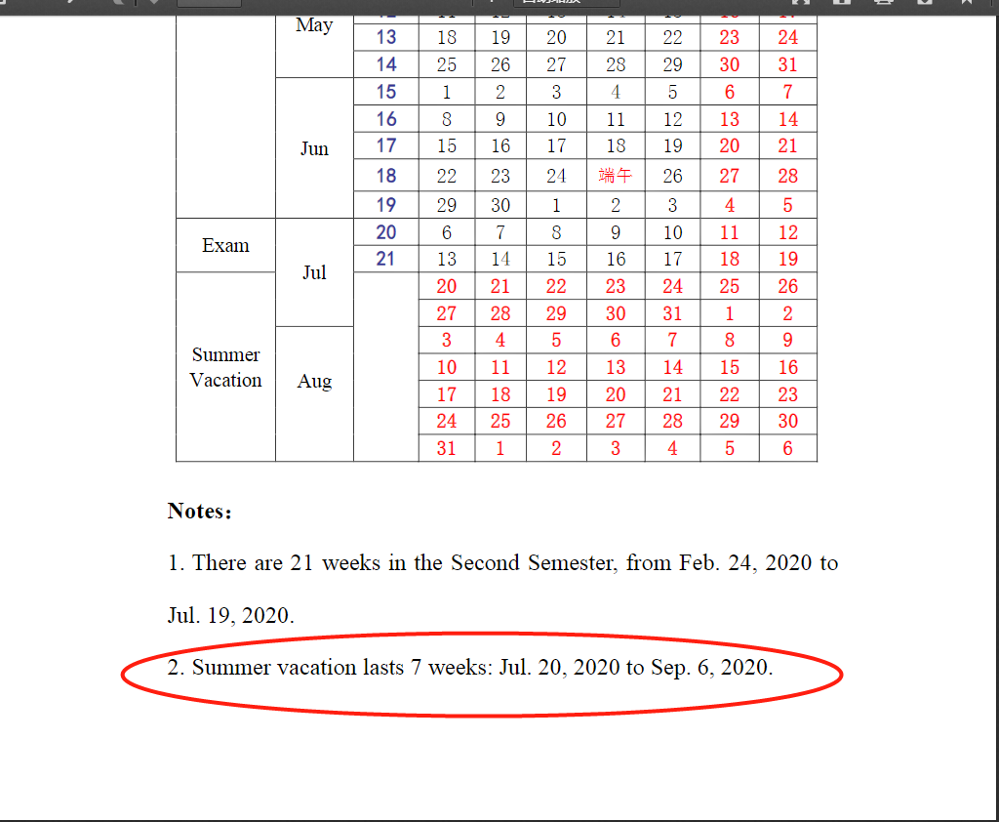
summer vacation:Jul. 20-Sep. 6
make-up exam: Aug.31-Sep.5
students outside temporarily must return on Aug. 30

Slide 4
Student management&
Safety issues
02
PART 02

Slide 5
DORM ISSUES
dorm rules!
http://international.cpu.edu.cn/3a/78/c403a14968/page.htm
irregular dorm check
during the holiday
hosting firends overnight
dorm issues
detailed scores are given.
violation of the dorm rules
will be marked.
cigerrattes
lighting incenses
personal staff along the corridor
dirtiness and messs
illegal appliances

Slide 6
Safety Issues
Students who remain on campus
1. obey all the rules and regulations
2. no hosting guests overnight, no visitors after 10pm
3. fighting or drinking on campus is forbidden
4. daily health report
5. temperature test twice
6. lockdown management：application to go outside
7.logistic support：canteen&supermarket, self-service machines

Slide 7
Safety Issues for Students who will move outside campus during summer vacation
1. turn off the electricity，lock the door and window
2. drink enough water, avoid heat-stroke,wild swimming is forbidden
3. do not travel outside China or travel to middle or high-risk areas, travel long distances across provinces, contact with people from middle or high-risk areas
4.do not over drink alcohol or go to bars
5.abide by the epidemic prevention and control rules ,daily health report
6. come back on August 30

Slide 10
03
Visa
PART 03

Slide 11
Attendance Rate and Visa
rules on visa: http://international.cpu.edu.cn/9c/b6/c403a105654/page.htm
attendance rate
＞ 80%
attendance rate
between 70%~80%
attendance rate
below 70%
poor academic record
lack of financial support
demerit record
Residence Permit for one year and are eligible for work-study
180 days study-type Residence Permit
not eligible for study-type Residence Permit
Universities are required to provide students' attendance rate and academic record in the visa extension letter by the Nanjing Police.
more than 5 students who paid for one year but attendance rate is between 70-80%???

Slide 12
VISA EXTENSION LETTER
attendance rate
academic record
current visa number
please do take your passport vith you for the visa extension
don't wait till the dealine, apply the visa extension 2 weeks in advance!!

Slide 13
Check your visa expiration date! keep it in mind, don't miss the deadline!!
If you haven't completed the next semester's payments, please prepare the money in advance and conduct the Online Payment. tuition, accommodation (if living on-campus. Off-campus residents must provide up-to-date contract.) and insurance .
Final-year students may pay for one year before Sep. 5 to get the Residence Permit.
All students are strongly advised to apply for resident permit at least two week beforehand and don’t wait till the last day of visa expiration.
Visa

Slide 14
1. epidemic prevention and control rules
2. protect yourself
3.for any kind of emergency, please contact your class monitor and class mentor immediately
4. be aware of your visa expiration date, extend your visa early as possible
5. students outside temporarily must return on Aug.30

Slide 15
Wish you a happy and safe holiday!!

